Slide 1

AI-Based DDoS Detection & Automatic Prevention
CSA0707 – Computer Networks
Course Faculty :
Dr. Shankar Ramalingam
PRESENTED BY :
Avinash M (192521196)
Althaf A (192521257)
Rithik Rakshgan (192524419) Vikesh N (192312022)

Slide 2


Introduction
Distributed Denial-of-Service (DDoS) attacks overwhelm a network or service with excessive traffic.
Such attacks can cause slow performance, service unavailability, and resource exhaustion.
Traditional threshold-based detection may struggle with changing traffic patterns.
Artificial Intelligence can identify suspicious patterns from network traffic characteristics.
The proposed system combines network monitoring, Machine Learning, and automatic prevention.

Slide 3
Objective
Develop a software-based system for real-time DDoS detection.
Simulate normal and suspicious network traffic in a controlled local environment.
Extract useful network features from observed traffic.
Train a Machine Learning model to distinguish Normal and DDoS traffic.
Automatically respond to detected malicious traffic.

Slide 4
Problem Statement
DDoS attacks can generate extremely high traffic within a short period.
Sudden traffic spikes can consume server, network, and application resources.
Static traffic thresholds may produce false positives or false negatives.
Manual attack identification and response can introduce significant delay.
Network administrators need continuous visibility into traffic behavior.
Identifying suspicious source devices is difficult during high-volume traffic.

Slide 5
Proposed Methodology
Generate controlled normal and DDoS-like traffic in a local simulation environment.
Monitor incoming traffic and collect relevant network statistics.
Extract features such as packet rate, request rate, byte rate, and source count.
Feed the extracted features into a trained Random Forest classifier.
Classify the observed traffic as Normal or DDoS.
Generate a confidence score for the AI prediction.

Slide 6
Methodology Flow
Traffic Simulation
↓
Traffic Monitoring
↓
Feature Extraction
↓
AI/ML Detection
↓
Normal / DDoS
↓
Automatic Prevention
↓
Security Dashboard

Slide 7
System Architecture Components
Traffic Generator – produces controlled network traffic.
Traffic Monitor – collects and analyzes traffic activity.
Feature Extractor – converts traffic data into ML features.
AI Detector – classifies traffic using the trained Random Forest model.
Prevention Engine – automatically blocks detected malicious sources.

Slide 8


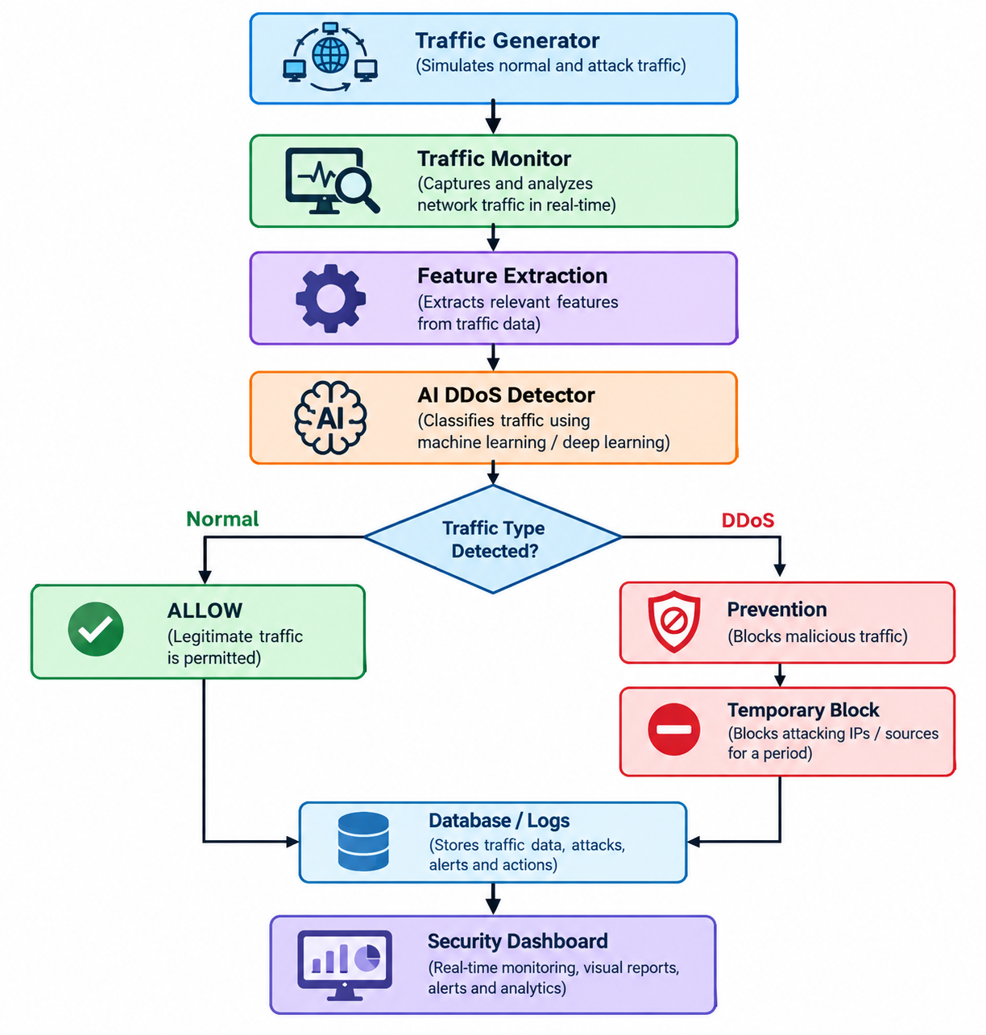
Architecture Flow

Slide 9
Module 1 — Network Traffic Simulation & Monitoring
Creates a local software-based network environment for testing DDoS behavior.
Generates both normal traffic and suspicious/high-volume traffic.
Simulates multiple devices using different source IP addresses.
Continuously monitors requests, packets, bytes, and traffic rates.
Maintains a 5-second traffic analysis window for real-time monitoring.

Slide 10
Module 2 — AI-Based DDoS Detection
Converts monitored network traffic into machine-learning features.
Uses features such as packet rate, byte rate, connection/source rate, and request rate.
Generates a labeled dataset containing Normal and DDoS traffic patterns.
Uses a Random Forest Classifier for traffic classification.
Trains the model using historical/simulated network traffic data.

Slide 11
Module 3 — Automatic DDoS Prevention & Security Response
Receives the DDoS prediction from the AI detection engine.
Identifies the source IP/device associated with suspicious traffic.
Automatically applies a temporary blocking mechanism.
Prevents further traffic from a blocked source during the mitigation period.
Maintains an active blocklist with expiration times.

Slide 12
Module 4 — Security Operations Dashboard & Device Intelligence
Provides a real-time Security Operations Center (SOC)-style dashboard.
Displays traffic status, request rate, packet rate, AI confidence, and threat counts.
Visualizes live network traffic analytics using a continuously updated chart.
Displays simulated device locations and geographic network activity.
Shows device IP, device ID, location, traffic rate, AI result, and security status.

Slide 13
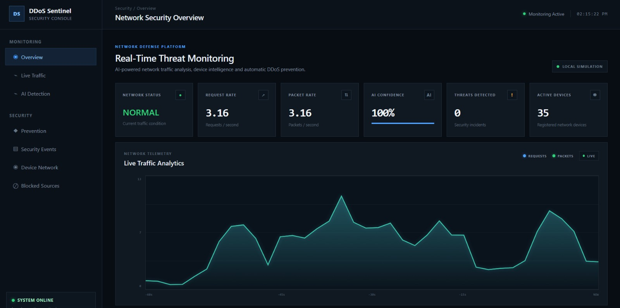
Implementation

Slide 14
Automatic Prevention & Response
The prevention module receives the ML prediction.
When traffic is classified as DDoS, the source IP is identified.
The malicious IP is added to a temporary block list.
In our implementation, the default blocking period is 15 seconds.
Requests from blocked sources are rejected during the blocking period.
Expired blocks are automatically removed.

Slide 15
System Output & Performance
Successfully generates normal and DDoS-like traffic locally.
Provides real-time traffic monitoring through the dashboard.
ML model performs automatic traffic classification.
Suspicious source IPs are identified at device level.
Automatic temporary blocking works without manual intervention

Slide 16
Limitations of the Proposed System
The system uses simulated network traffic instead of live enterprise traffic.
Detection accuracy depends on the quality and representativeness of the training dataset.
The current implementation supports Normal and DDoS classification only.
Temporary IP blocking is implemented for simulation purposes.
The system is designed for localhost/software-only deployment.
It does not currently integrate with real routers, firewalls, or IDS/IPS hardware.

Slide 17
Advantages & Disadvantages
Advantages
Disadvantages
Provides automated DDoS detection using Machine Learning.
Reduces dependence on manual traffic monitoring.
Enables automatic response to detected malicious sources.
Provides real-time network visibility through the dashboard.
Tracks source devices and simulated geographic locations.
Current implementation is primarily a controlled local simulation.
Simulated locations do not represent real-world IP geolocation.
Detection performance depends on the quality of training data.
A trained model may not identify every new or unseen attack pattern.
The current prevention mechanism is designed for the simulator.

Slide 18
Future Scope
Integrate real network packet capture and live network interfaces.
Support additional DDoS attack categories and traffic protocols.
Use larger real-world network-security datasets for model training.
Compare multiple Machine Learning and Deep Learning algorithms.
Add real IP reputation and geolocation services.

Slide 19
Conclusion
The project demonstrates an integrated approach to DDoS detection and prevention.
Network traffic is continuously monitored and converted into useful features.
Machine Learning is used to identify suspicious traffic patterns.
The Random Forest model classifies traffic as Normal or DDoS.
Detected malicious sources can be automatically blocked.

Slide 20
References
[1] I. Sharafaldin et al., “Developing Realistic DDoS Attack Dataset and Taxonomy,” IEEE ICCST, 2019.
[2] Z. He et al., “Machine Learning Based DDoS Attack Detection from Source Side in Cloud,” IEEE CSCloud, 2017.
[3] R. Doshi et al., “Machine Learning DDoS Detection for Consumer Internet of Things Devices,” IEEE SPW, 2018.
[4] “DDoS Attacks Detection and Mitigation in SDN Using Machine Learning,” IEEE SERVICES, 2019.
[5] “Online Network DoS/DDoS Detection: Sampling, Change Point Detection, and Machine Learning Methods,” IEEE Communications Surveys & Tutorials, 2025.
[6] Canadian Institute for Cybersecurity, “CICDDoS2019: DDoS Attack Dataset,” University of New Brunswick, 2019.

Slide 21
THANK YOU…

